Slide 1
About Me
Lucrecia Aguilar
10/15/19

Slide 2
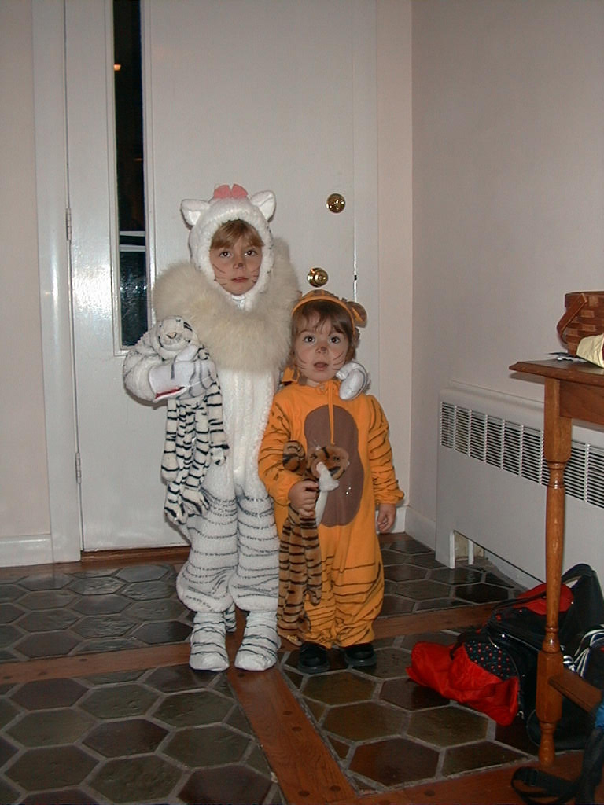
Notes:
-since watching the Lion King
-brought passion into all aspects of life
-in Boston, there aren’t exactly a bunch of big cats roaming around, so turned to biology to start engaging with my passion for animals
-conservation biology: learned about 6th mass extinction going on

Slide 3
https://petapixel.com/2019/10/01/photos-of-endangered-species-where-every-pixel-represents-one-animal/

Slide 4

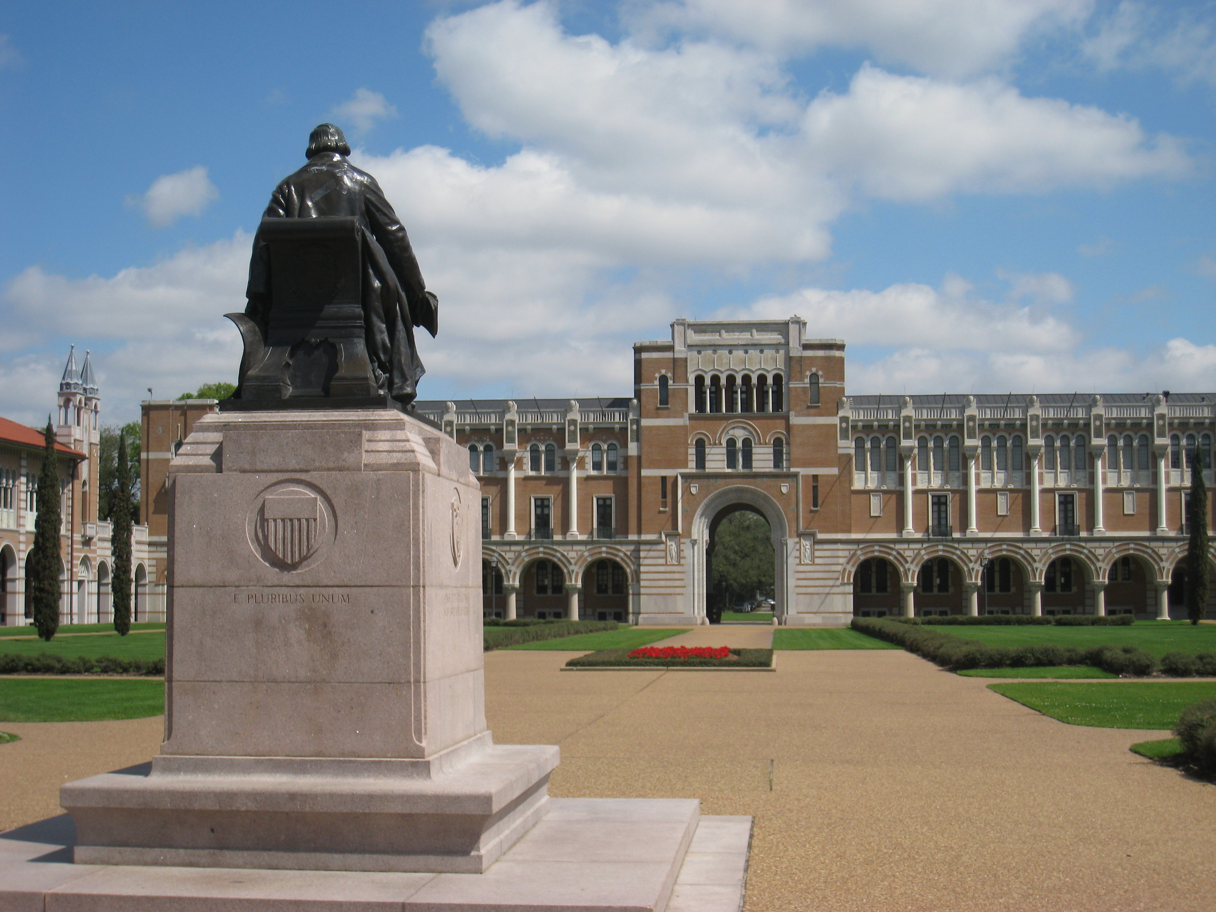
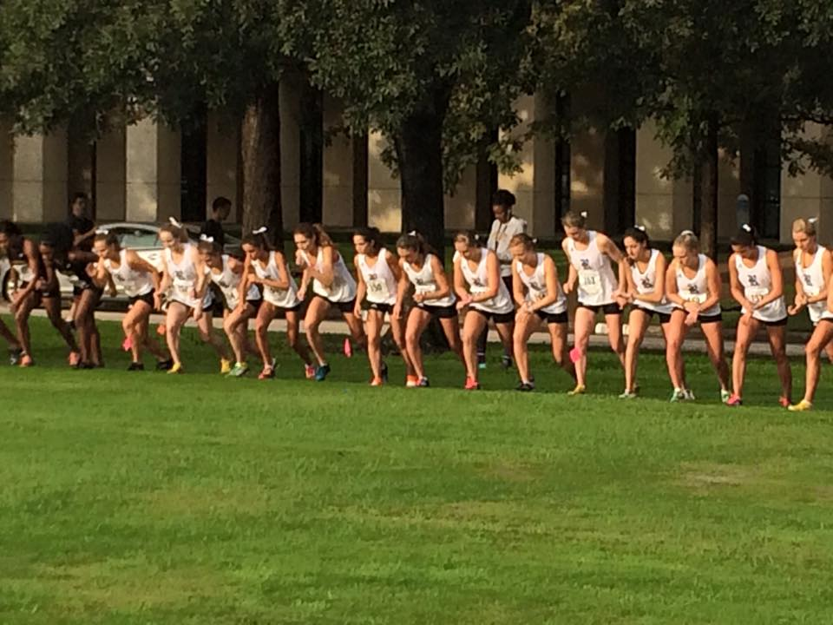
https://commons.wikimedia.org/wiki/File:Rice_University_-_Rice_statue_with_Lovett_Hall.JPG
Notes:
-chose a college with a good ecology program so I could learn about species
-also other things: campus life, track → importance of this in choosing a college, life isnt just school here
-made sure to get myself involved in science outside the classroom through research experiences

Slide 5
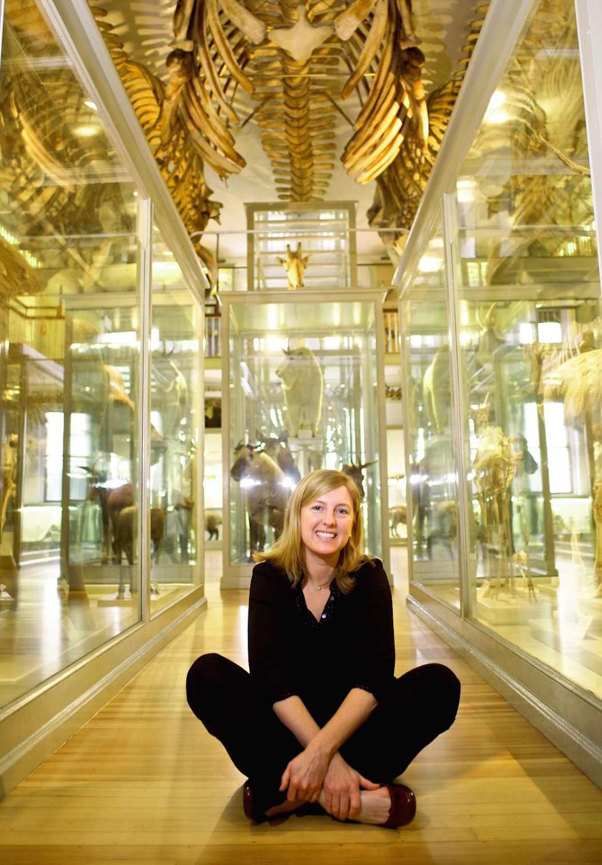
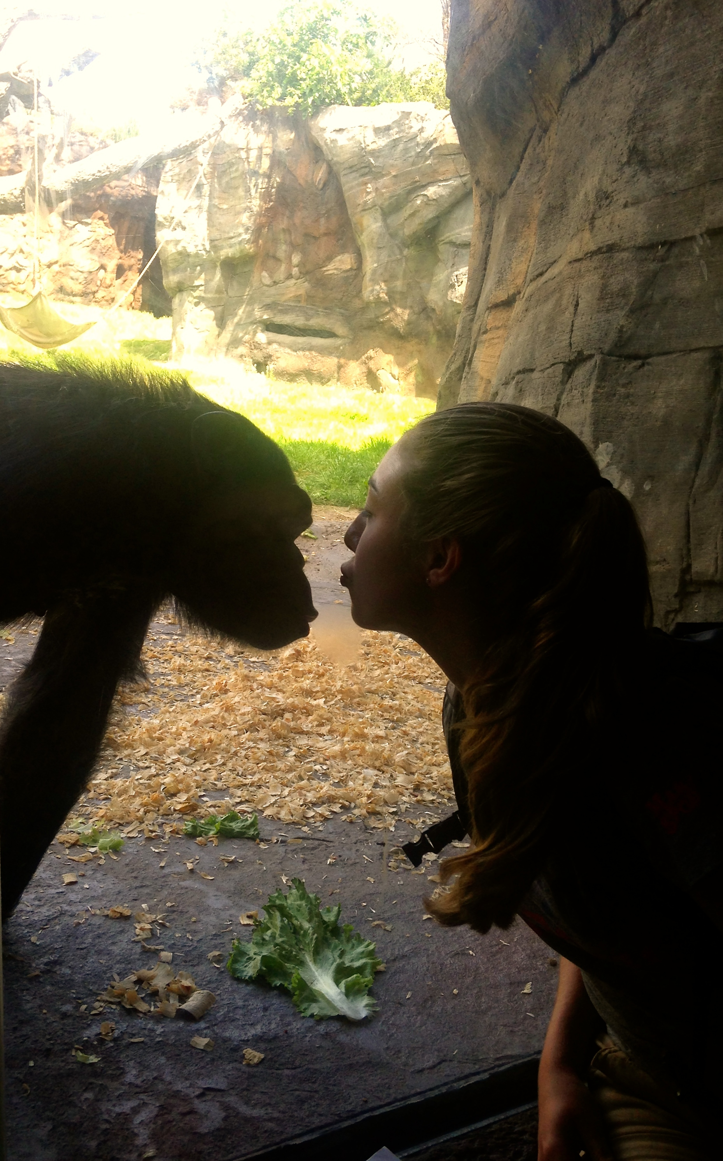
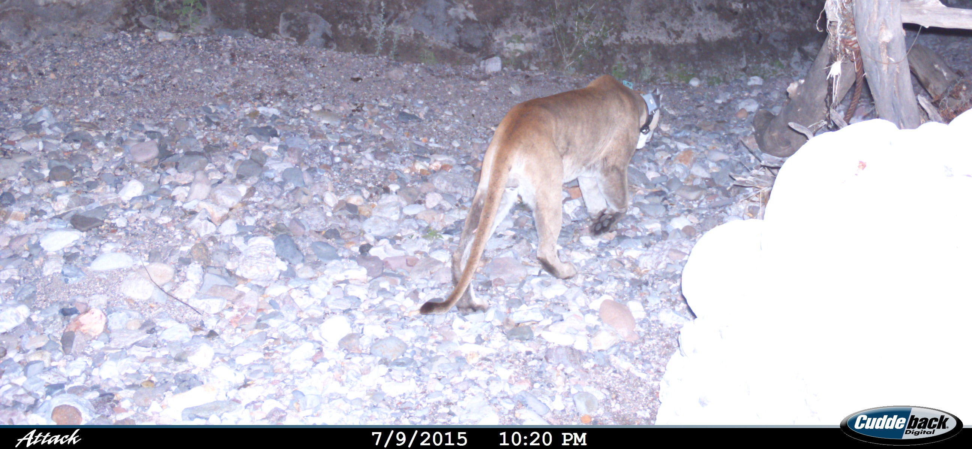
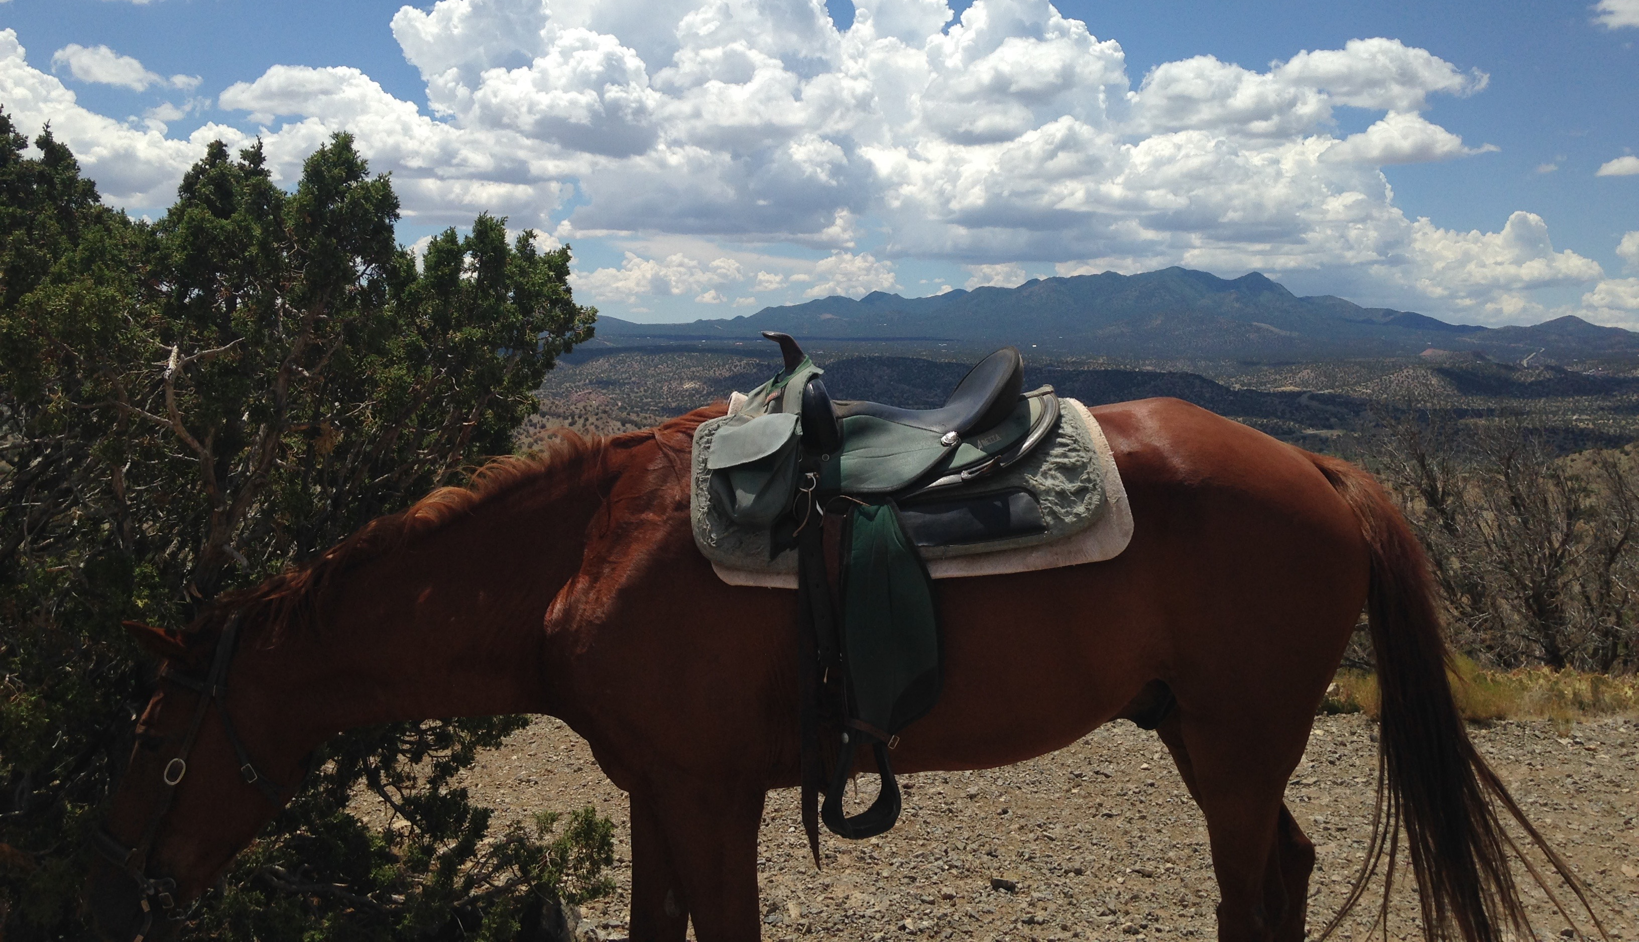
https://commons.wikimedia.org/wiki/File:Hoekstra_MCZ2.jpg
Notes:
Chimpanzee and orangutan research at houston zoo (Tanzee and friends)
Summer research at Harvard with this woman (Dr. Hopi Hoekstra) at Harvard Museum of Natural History; also studied relationships b/w bones and behaviors, but in mice
Tropical ecology course in Belize through Rice
-emailed a professor working with cougars in New Mexico, applied for and got money from Rice to go work with him
-studied cougars
-also worked at a horse ranch to make money
-then decided I wanted to study wildlife outside of the US

Slide 6
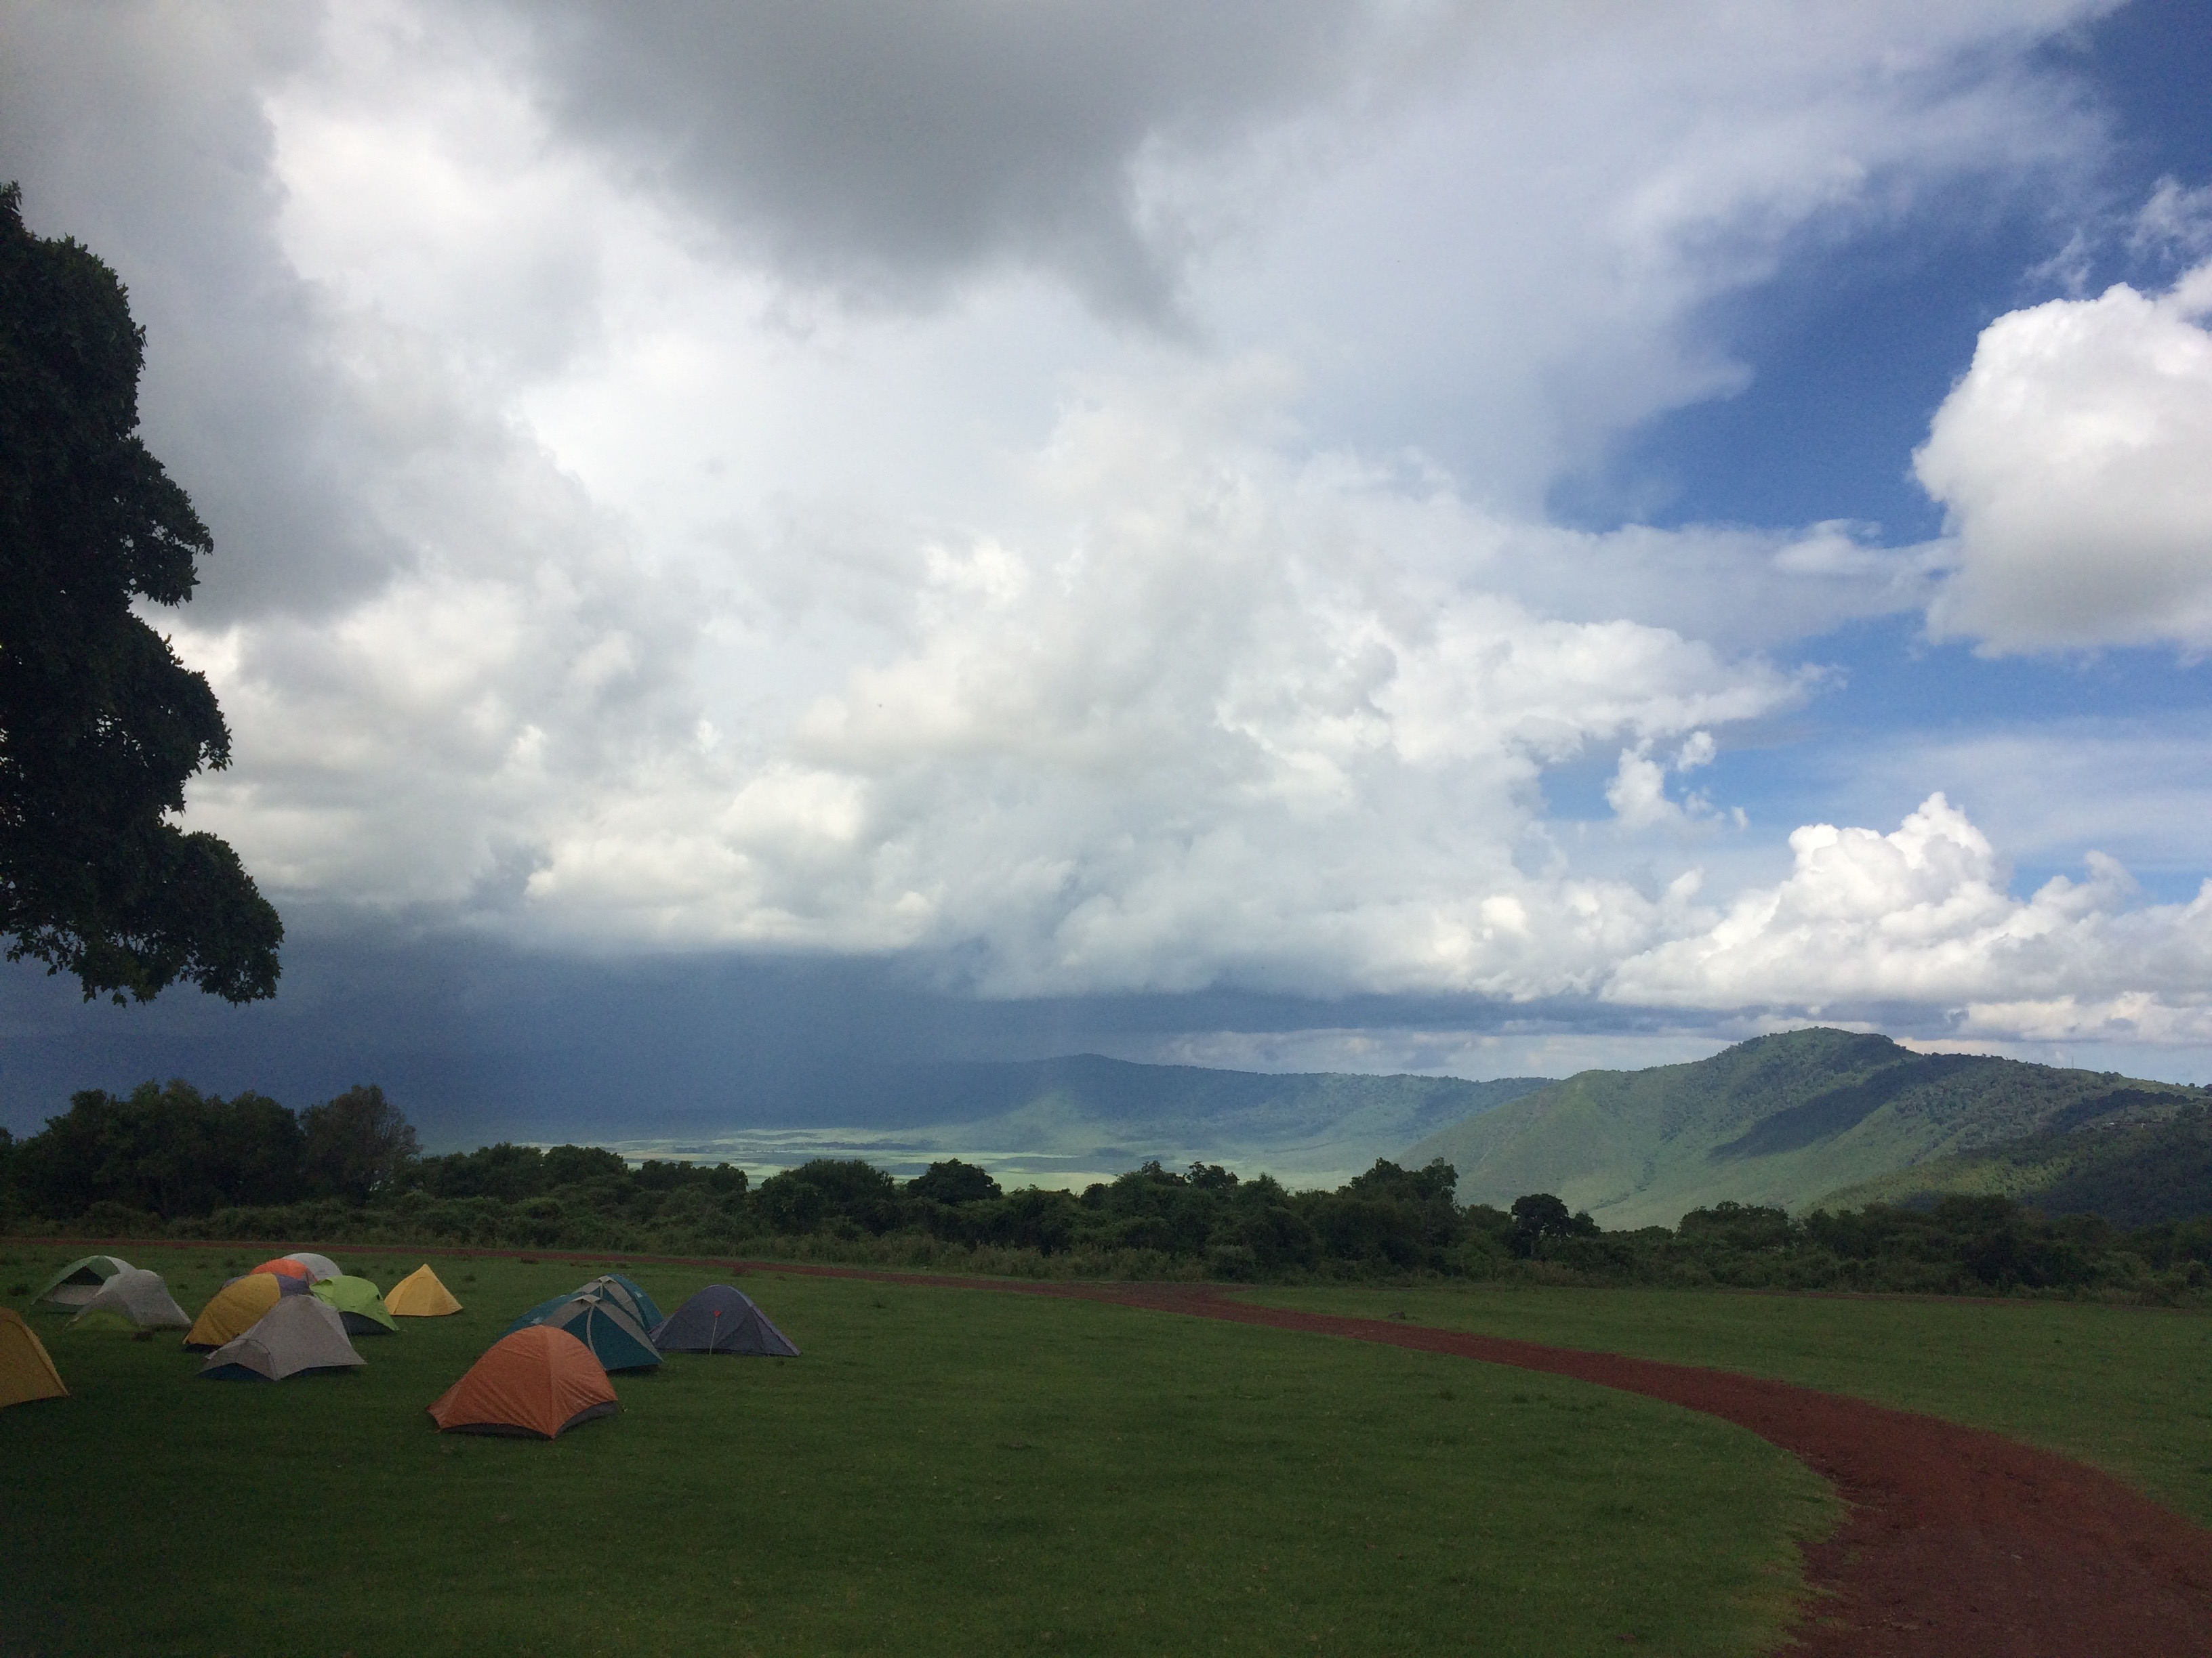
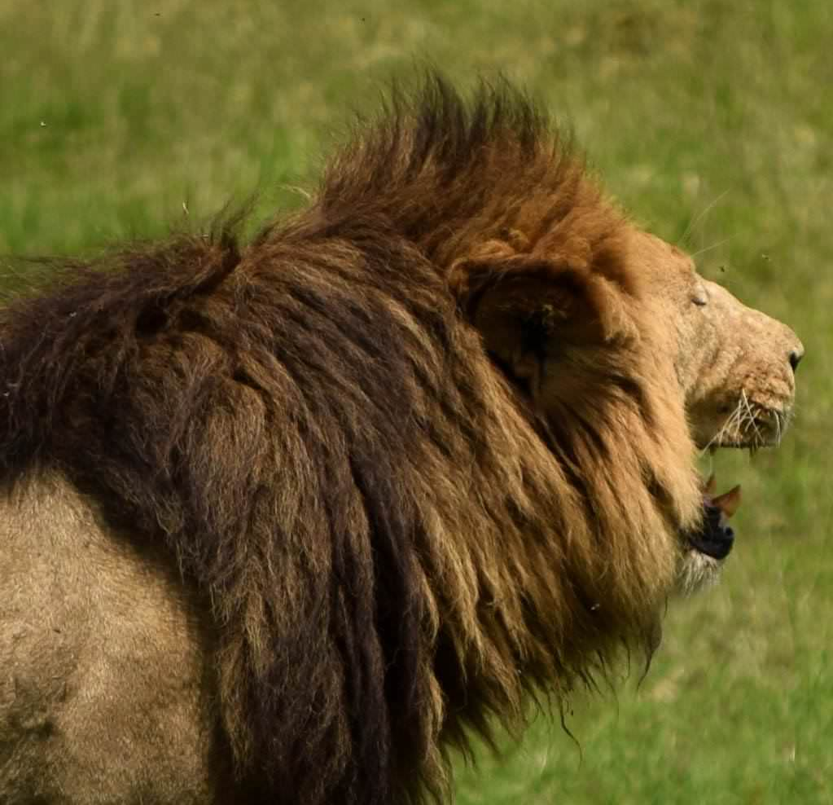
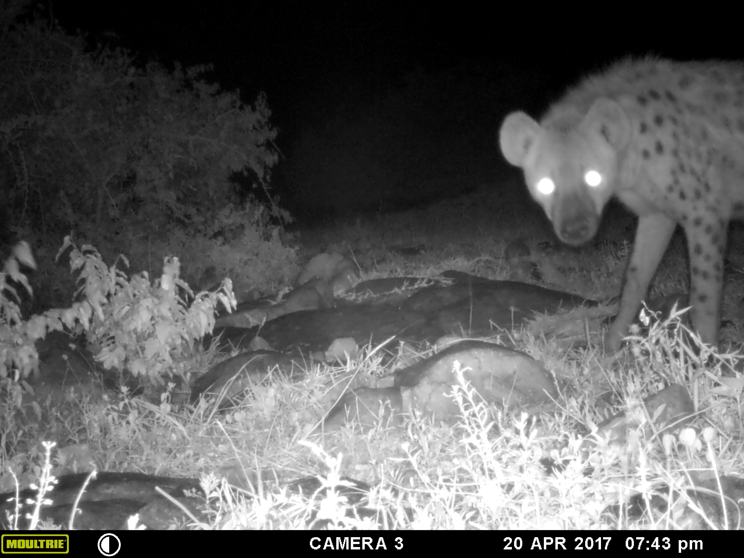
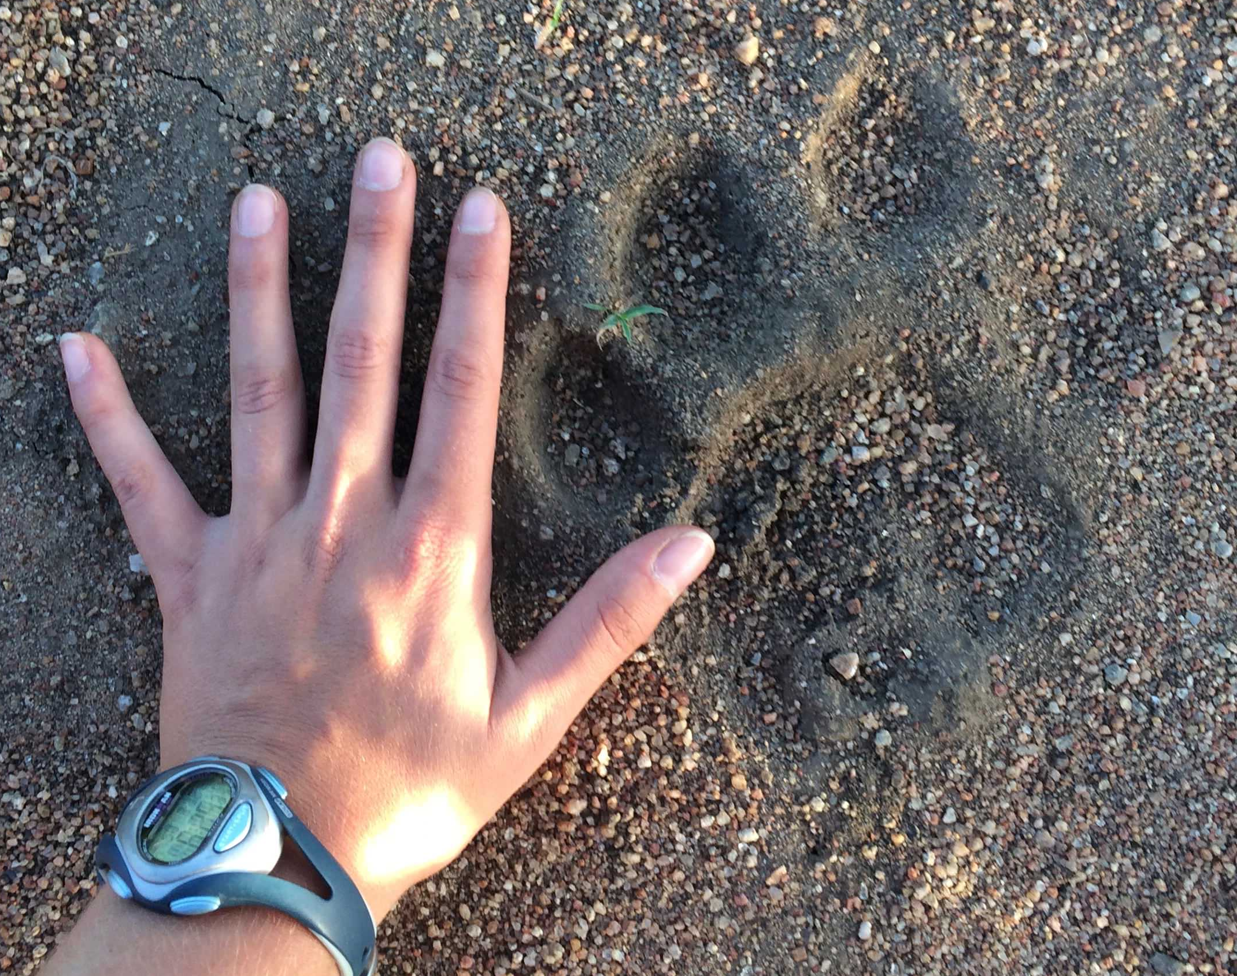
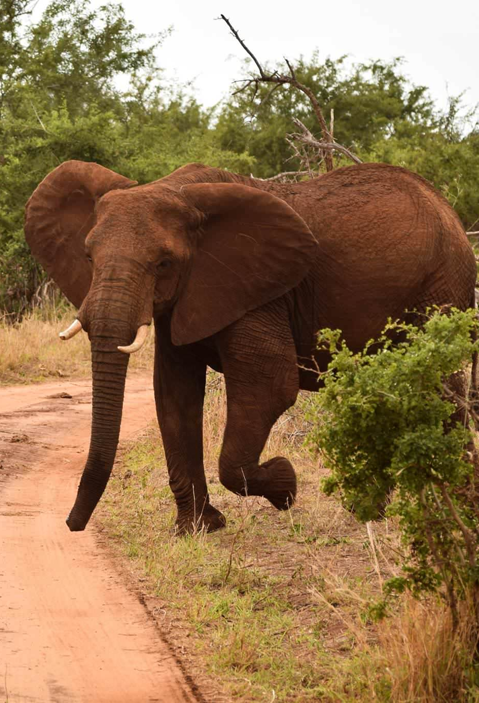
Notes:
-Studied abroad in Tanzania, East Africa for a semester; common thing for college students to spend one semester in another country
-amazing.
-really encourage you to study abroad if at all possible because it’s a great intro to real science and study outside the textbook

Slide 7
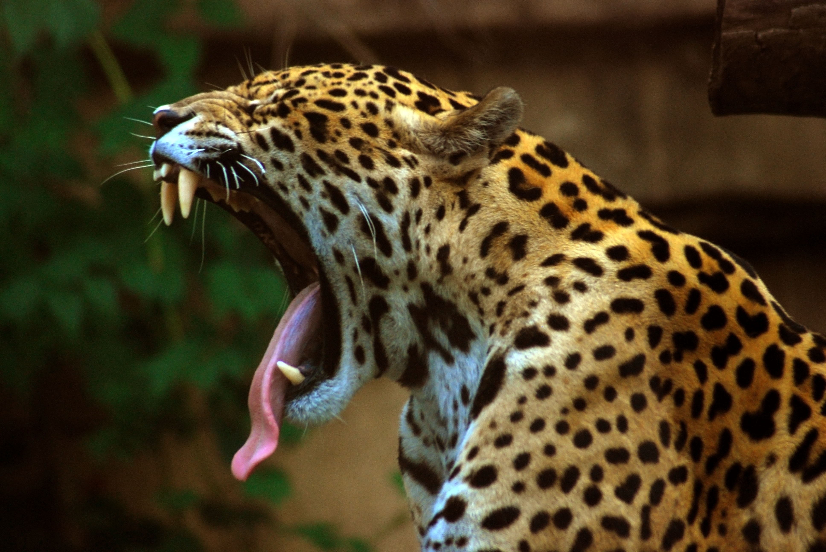
Senior Honors Thesis
https://en.wikipedia.org/wiki/Jaguar
Main Question
How does timber logging in tropical rainforests impact jaguar activity?
Notes:
-Began a project, my final big research project for Rice, on jaguars
-Did fieldwork for 2 months in the jungles of Belize, then used statistics and R to analyze my data

Slide 8
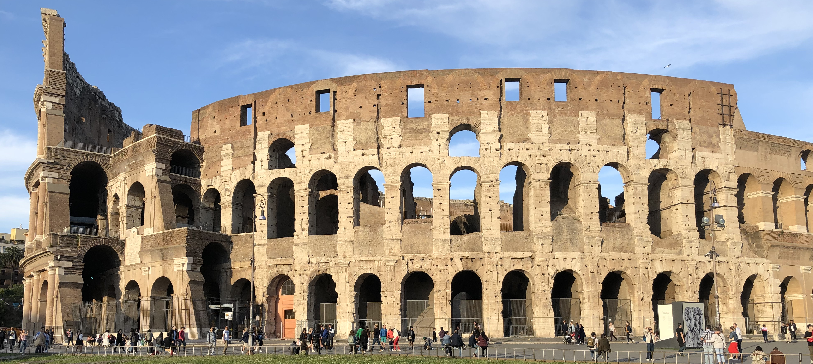
Notes:
Watson Fellowship
17 countries to study big cat conservation and the relationships between people and wildlife
Lots of different species!
Still processing the experience and sorting through 12000 photos, but was the most incredible year of my life

Slide 9
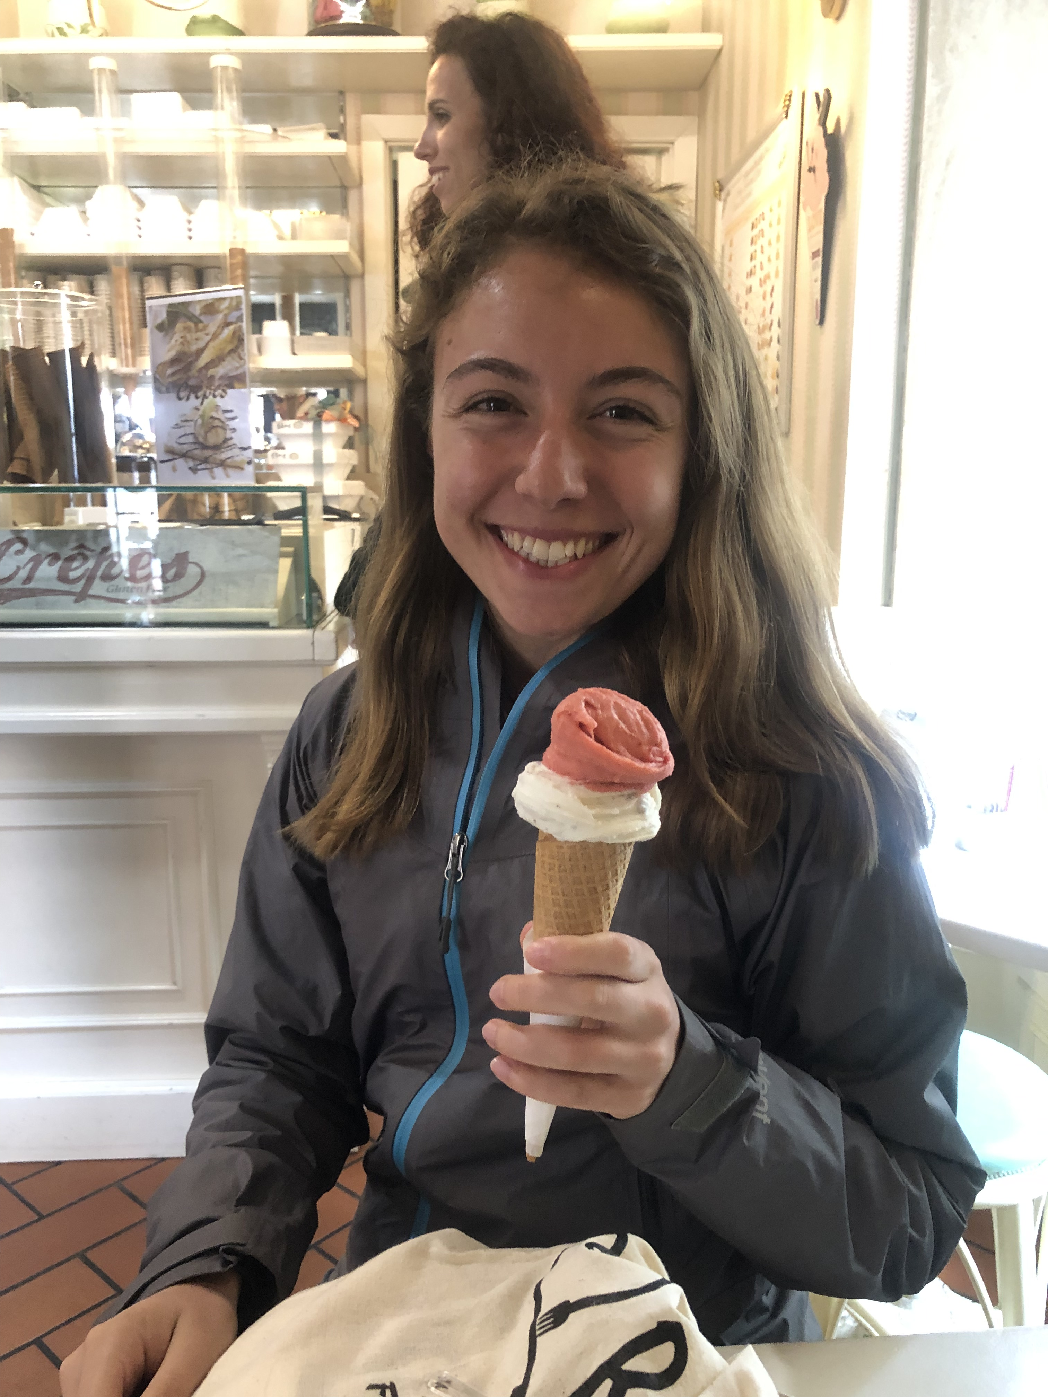
https://en.wikipedia.org/wiki/Guatemala
https://www.pinterest.com/pin/17803361004792796/?nic=1
Notes:
Fun facts
Live in Brooklyn
Family from Guatemala
Huge foodie

